Slide 1
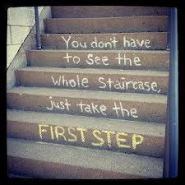
Little bit at a time

Slide 2
Your Future
Think
Where will you be in 5 years?
Where will you be in 10 years?
Where will you be in 20 years?

Slide 3
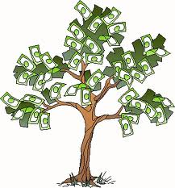
The Future COSTS
Life After High School isn’t cheap…..
Living on your own:
$1,000 Rent 1 bedroom apt. in Central Jersey
$200 Monthly utility bills (electric, gas)
$50 Cell Phone bill
$600 Transportation (car, insurance, gasoline)
$400 Food
$150 Clothing
$200 Entertainment
$130 Medical Care
$500 Other (repairs, gifts, trips)
Monthly that means…..
$3,380
Yearly that means….
$40,560
This means you must make __$21__ an hour to pay for all of these things.
Note: This doesn’t take into consideration the cost of Middlesex County College where you must pay up front an extra $2,050

Slide 4
Jobs/Careers
Jobs/Careers that make over
$35, 000
Teacher
Investment Baking Analyst
Assistant Actuarial Analyst
Junior Tax Associate
Pharmaceutical Sales Rep
Auditor
Wind Turbine Technician
Health Care Research Analyst
Search Engine Optimization (SEO) Analyst
Forensic DNA Analysis
Law Research Associate Jobs
All these jobs Start under 50, 00 dollars and this is with a college degree.
-All of these jobs you will have to work your way up the pay scale. You have to PUT TIME IN.
After Graduation there is no guarantees, you must win or be better than someone else to get one of these jobs.
Once you win and get that job you must start at the BOTTOM and work your way up.

Slide 5
Careers
What’s a career?
An occupation undertaken for a significant period of a person's life and with opportunities for progress
How many Careers will you have?
How many Careers do people have typically?
It is actually 4-6

Slide 6
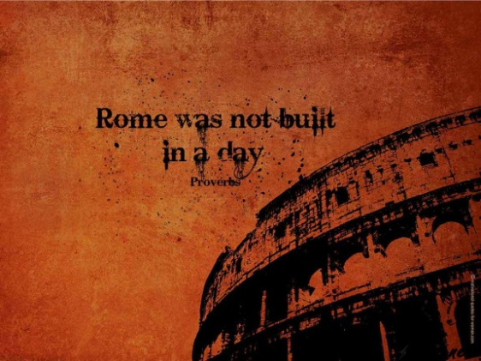
Work Ethic and Patience
Are you going to be the one who works hard and gets the job/career?
If yes, it takes hard work ethic and patience.
If no, you will not be in that job/career for long and you will never move up the ranks to finally make some real money.
Now is the time to build and practice your patience and work ethic. Do this in your classes, internship and life!!

Slide 7
Work Ethic and Patience
Work Ethic - is a belief in the moral benefit and importance of work and its inherent ability to strengthen character.
Work ethics is important because it provides a business environment with a stable foundation, therefore allowing for successful business growth and development. Work ethics provide a professional attitude and honest policies.
Patience- is the capacity to accept or tolerate delay, trouble, or suffering without getting angry or upset.
You need these qualities now, life is not made up of INSTANT GRATIFICATION, NOW NOW. GIMMEE GIMMEE

Slide 8
College
Society has made College a mandatory requirement.
College is a way to build upon your work ethic and patience
College will allow you to make more money in long term.
You don’t have to pay for college until months after you are done with college.
College is different from High School and anything else in life.

Slide 9
Differences in College
4 Different types of programs after High School:
Certificate Program- Certificates are specialized training in an particular area. If you get hurt or do not like that job after some time that certificate is useless.
Example: Carpentry, Nurse Assistants, Phlebotomy, HVAC
Associate Program- An Associate degree in Arts, Science, Liberal Arts, Business is where you can do any job in that field of study.
Nurse, communication, business administration, computer graphics, criminal justice, psychology
Bachelor’s Degree- Higher then a Associates Degree. A Bachelors Degree in Art or in Science. You can do any job in that field of study.
Majors: Criminal Justice, Phycology, Business, Marketing, Nursing, Computer information systems, biology, athletic training. communication, art

Slide 10
Paying for College
Paying for college is a scary feat.
How will you do it?
There is government money- Financial Aid.
FASFA- tell you how much money you can get from the government based upon how much your parents make in a year.
Subsidized loans are awarded on the basis of financial need. You won't be charged any interest before you begin repaying the loan because the federal government subsidizes the interest during this time. (Perkins/Stafford Loans)
Unsubsidized loans charge interest from the time the money is first disbursed until it is paid in full. The interest is capitalized, meaning that you pay interest on any interest that has already accrued. One way to minimize how much interest accrues is to pay the interest as it accumulates.
Scholarship Money- Free money to pay for college/books. Students may be eligible to receive scholarships based on attributes such as ethnicity, major, location, GPA, year in school, organizations of interest, etc. Even average students, whose reports cards and resumes don’t particularly shine, can find numerous awards for which they may qualify.
Grant Money- grants are primarily awards of free money, that do not require any repayment on the part of the recipient. Unlike scholarships, which are typically awarded on the basis of academic achievement or athletic, artistic or extracurricular performance, grants are awarded according to financial need. This is not to say that academic merit will not be considered, only that financial need is given greater weight in the final decision making process.

Slide 11
www.Collegeboard.com
Research Research Research- It’s your future and you need to make it happen!!
Create a Profile
Look up majors and see what classes you will have to take in that particular field and WRITE three down that interest you. By Junior year we can pick what one is best.
Look at sizes of school and who offers support services
Talk with your family or bring them in to discuss with Mr. Criscera.

Slide 12
Closing Time
Here at the PLA you have opportunities to express yourself and test the waters out in the real world, and actually see what you like.
TAKE ADVANTAGE!
I want everyone in this school to be able to say what they want to do when they graduate. I am in the guidance office, come down and discuss your ideas.
Any questions or concerns?
One cannot discover new oceans unless they have the courage to lose sight of the shore. - André Gide

